Slide 1


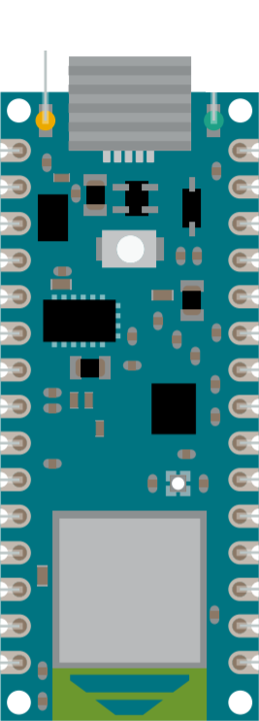
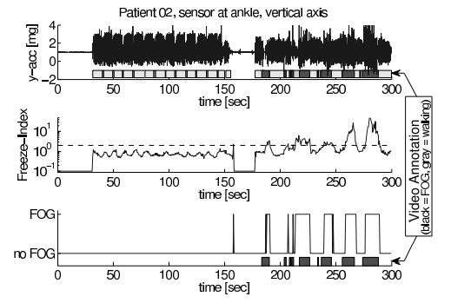
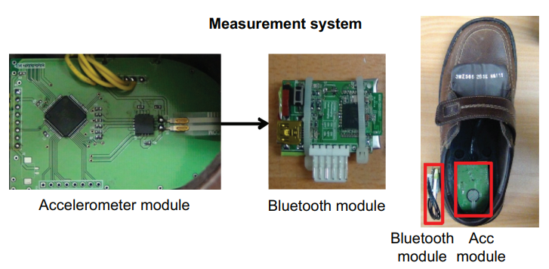
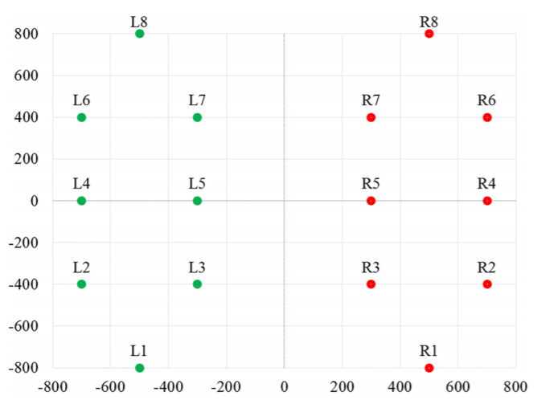
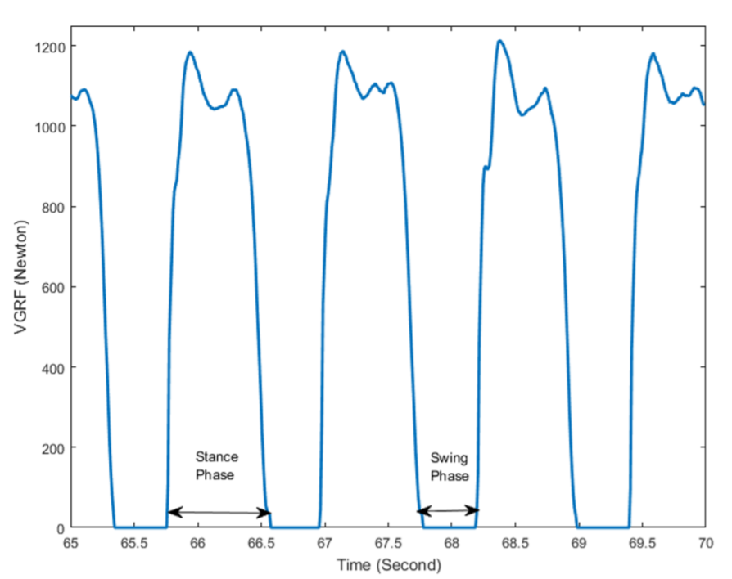
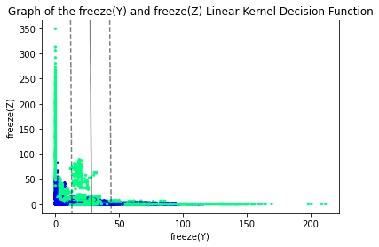
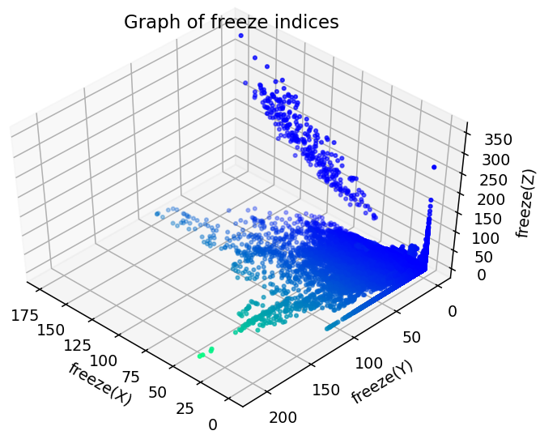
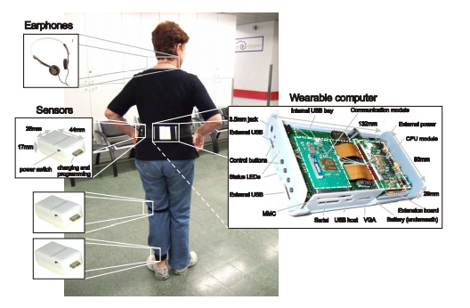
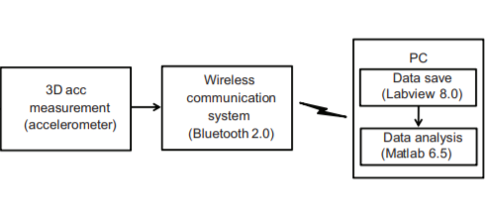
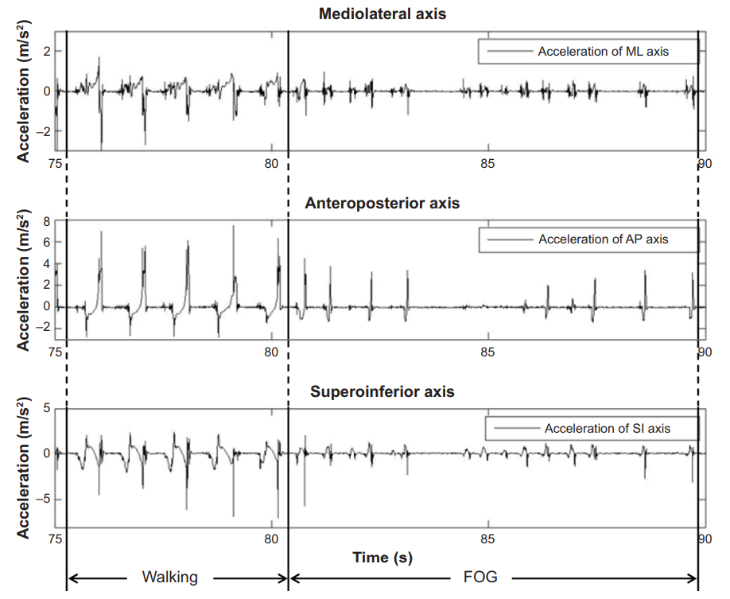
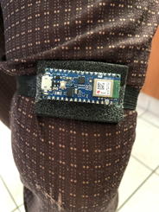
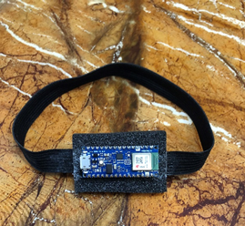
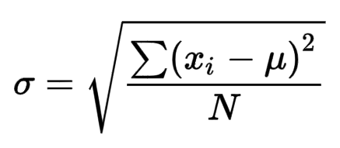
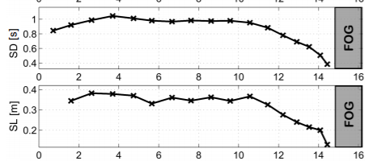
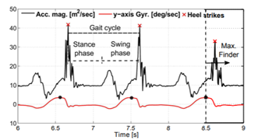
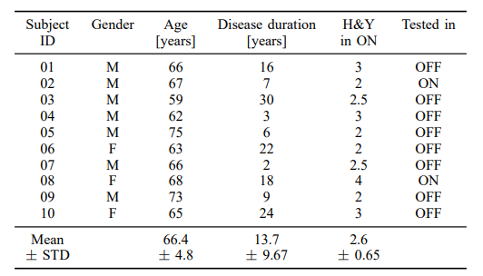
Gait Monitoring and Analysis for Parkinson’s Disease Patients
Nallapuraju Ananya, Ye Chen Rui and Prannaya Gupta
Introduction
Methodology
Parkinson’s disease (PD) is a neurodegenerative disorder that affects the dopamine producing neurons in the substantia nigra, an area of the brain, leading to shaking, stiffness and difficulty walking. Parkinson’s patients frequently exhibit the debilitating condition freezing of gait (FOG), which is when patients cannot move their feet forward despite the intention to walk. While the feet remain in place, the torso still has forward momentum, making falls very common. At the start, FOG can be triggered by stress, tight spaces or a sudden change in direction. As the disease progresses, this happens more frequently, a fact extremely detrimental to the patient’s health and mental well-being.
DaphNET Dataset
17 samples from 10 PD patients’ acceleration data from the hip, thigh and ankle.
built-in LED
Windowing of data and performing a Fast Fourier Transform on the window, giving a postulated Freeze Index, while applying a threshold for standing cases. Here, we defined freeze(N) as the Freeze Index postulated from N-axis acceleration.
Signal Processing
Aims and Objectives
Support Vector Machine (SVM) Analysis
Linear and Gaussian SVM kernels against each of the freeze indices, based on either 2D (2 out of 3 axes) or 3D data.
The aim of this project is to identify the parameter which is most suitable for classification of FOG in PD patients. It also aims to compare multiple machine learning models based on acceleration data from accelerometers placed on the thigh.
Public datasets of PD patients will be analysed to extract the motion pattern of PD patients. A Freeze Index value is postulated and used to predict FOG based on these parameters. Ultimately, a prototype that fulfils all these requirements will be developed.
Run in Python operating on an Arduino Nano BLE 33, using the best SVM model predicted. The built-in LED lights up upon the predicted freeze event.
Arduino Program
Literature Review
Accelerometers have been chosen to be the main focus of the data analysis as they are very versatile. Research has shown that accelerometers can be used to determine stride time, gait cycle and gait velocity. Hence, they would be a good starting point. The axis used is based on X being horizontal forward, Y being vertical and Z being horizontal lateral with respect to the user.
Utilisation of Inertial Measurement Units (IMUs)
IMU | Purpose | Measured Parameter
Accelerometer | Measuring acceleration | Stride Length, Stride Duration
Gyroscope | Measuring angular velocity | Step Festination, Gait Asymmetry
Flexible Goniometer | Measuring body joint angles | Flat Foot Strike
Force- sensitive Insole | Measuring the tension and compression forces that act on the sensor | Gait Cycle (not accurate for PD patients who suffer from flat footedness)
b. Vertical Ground Reaction Force measurement with force insoles - Alam et al.
Results
Accelerometers in shoes - Eom et al.
Upon performing the Signal Processing Algorithm on the DaphNET dataset data, the freeze indices are plotted against one another as shown on the right. This data is then tested using multiple parameters and 2 kernels, achieving the results below.
Based on the results, it is believed that the Linear kernel with parameters freeze(Y) and freeze(Z) is the best since it is highly accurate, specific and precise. After conducting an analysis, it is found that the weighted average value for precision and sensitivity/recall as 0.90 and F₁ score as 0.86. The decision boundary function is shown below on the left.
Table of Algorithm Evaluation Functions with regards to kernels and parameters
The system used to collect gait data consists of eight sensors beneath each foot and a recording unit. A small and light recording unit was carried at the waist. The subjects walked at their natural pace on level ground for two minutes, and data was acquired with a sampling frequency of 100 Hz.
In this experiment, measured signals at the 3D accelerometer module (mounted at sole) were transmitted to a PC through a Bluetooth 2.0 module at the back-lateral side of the shoe. Transmitted data was saved by custom-made Labview software and analyzed by a custom-made Matlab program.
3D-Accelerometer Wearable System - Bachlin et al.
Machine learning approaches
Support Vector Machine (SVM)
Considered the most accurate by Aich et al.
K-Nearest Neighbour (kNN)
Decision Tree (DT)
Naive Bayes (NB)
Threshold/ Logistic Regression
Time Series Analysis
Kernel | Linear Kernel |  |  |  | Radial Basis Kernel
Parameters | freeze(X) and freeze(Y) | freeze(X) and freeze(Z) | freeze(Y) and freeze(Z) | All 3 Parameters | freeze(X) and freeze(Y) | freeze(X) and freeze(Z) | freeze(Y) and freeze(Z) | All 3 Parameters
Specificity | 1.000 | 0.975 | 1.000 | 1.000 | 0.990 | 0.990 | 0.991 | 0.989
Sensitivity/ Recall | 0.000 | 0.243 | 0.006 | 0.002 | 0.174 | 0.183 | 0.163 | 0.260
Precision | 0.000 | 0.509 | 0.889 | 0.867 | 0.650 | 0.664 | 0.665 | 0.723
Accuracy | 0.903 | 0.904 | 0.904 | 0.904 | 0.911 | 0.912 | 0.911 | 0.918
F₁ Score | 0.000 | 0.329 | 0.011 | 0.005 | 0.275 | 0.286 | 0.262 | 0.382
Sensors are attached to the shank, thigh and lower back where the wearable computer is attached to. There is a notable drop in acceleration.
Summary of Gait parameters
Gait abnormalities | Definition
Step Festination | Shortening of steps
Decrease in Stride Duration | Decrease in the time difference between two consecutive detected acceleration peaks of the same leg
Postural Instability | Loss of balance
Increase in step-to-step time variability | Difference in time taken between each stride
Stride Length Reduction | Reduction in distance between each stride/step
Decreased Cadence | Decrease in number of steps taken per unit time
Gait Asymmetry | Difference in gait between the two legs of patient
Prototype
Gait Equations
Gait Parameters | Equation
Stride Length | Stride velocity (m/min) /0.5 cadence (steps/min)
Gait Variability | (*Standard deviation/Mean) x 100
In the end, a prototype has been developed to verify the effectiveness of parameters based on public dataset analysis.
It consists of an Arduino Nano BLE 33 board with a built-in 3D accelerometer and 3D gyroscope attached to an elastic band. It is small, light, very comfortable and is meant to be wrapped around the thigh.
*Standard Deviation:
for the stride length and step width of each participant
Conclusion
Public Dataset Analysis
An algorithm has been developed to identify the most suitable parameter for the classification of FOG in PD patients. Multiple machine learning models have also been compared based on acceleration data from accelerometers placed on the thigh. After analyzing, the most suitable parameters for classification are freeze(X) and freeze(Z) based on the acceleration data in the public datasets and the best model is the linear kernel model in terms of sensitivity. To make the result more reliable, freeze(Y) and freeze(Z) might also be considered.
Besides that, a prototype has been implemented to test the performance of the identified most suitable parameters.
Dataset used
The table above depicts the patients. Patient 08 and Patient 01 both suffered from walking difficulties due to disease severity and foot drop respectively.
DAPHNet dataset:
The result of a study done by Bachlin et al., carried out by the Laboratory for Gait and Neurodynamics, Department of Neurology, Tel Aviv Sourasky Medical Center (TASMC). In this experiment, 10 PD patients with varying Hoehn & Yahr (H&Y) scales were made to do various walking tasks, including walking back and forth in a straight line, doing several 180 degrees turns, random walking including a series of initiated stops and 360 degree turns and walking simulating daily activities.
Gait parameters focused
Although PD patients suffer from a variety of gait abnormalities, previous researchers have reported the importance of five parameters for the detection of PD. Most notably, Hollman et al. have proposed five major domains of gait based on factor analysis:
i. Rhythm - step and stride time
ii. Phase - gait cycle
iii. Variability - step-to-step variability
iv. Pace - gait speed, stride and step length
v. Base of support - step width.
Others have confirmed the importance of determining the spatiotemporal parameters. Hence, in this study, the focus will be on gait velocity, stride time and gait cycle.
Discussion and Future Work
Due to time limitations, only accelerometers were studied in this experiment. Multiple sensors can be worked on to achieve maximum accuracy. Additionally, only postulated freeze index values have been analysed based on the public datasets. Parameters such as Stride Length and Stride Duration have not been worked on. In the future, such parameters can be taken into account when computing the general gait freeze moment. The sensitivity of the algorithm should also be improved. Since the prototype has already been built, the next phase is to test it in a laboratory.
Furthermore, by connecting this system to earbuds and implementing biofeedback via audio, the system will also be able to mediate FOG. Another method involves connecting the system to an App such that notifications can be sent to the caregiver’s phone to alert them to a fall. This can be developed via Android App Development with Java/Kotlin or via frameworks like Kivy or Flutter for Python and Dart Programming respectively.
Acknowledgements
We would like to thank Professor Arthur Tay, Mr Lim Yeow Heng and Mr Lim Teck Choow for their support and encouragement in this study. The full source code and references can be found here: https://github.com/ThePyProgrammer/GaitMonitoringForParkinsonsDiseasePatients

